Slide 1
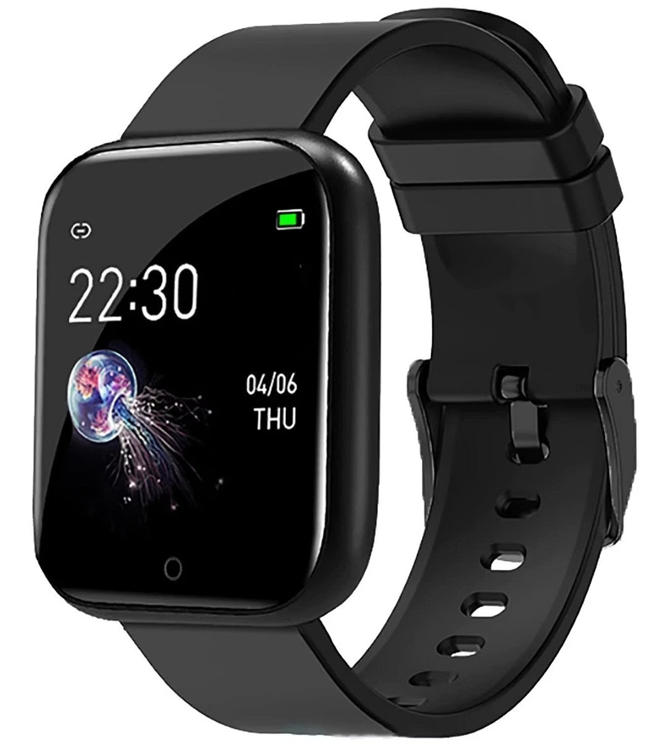
Health Tracker

Slide 2

why we use smart watch?
Calls
Messages
Notifications
Features

Slide 3
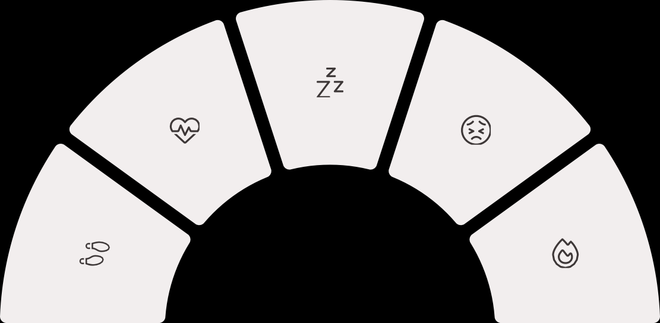
SENSORS
PPG+ACC+SpO2+ HRV
Maxim Max 86150, LSM6DSOX
Fitbit, Samsung, Garmin, Whoop
HRV from PPG + Electro Dermal Activity (EDA)+ Galvanic Skin Response (GSR)
EDA Sensor, GSR (Custom) Fitbit Sense,Galaxy Watch Samsung
Photo Plethysmo Graphy (PPG)
Maxim Max 86141, TIAFE 4950
Apple, Fitbit, Samsung, Garmin
Accelerometer sensor(ACC)
BMA 456, ADXL 362
Apple, Fitbit, Samsung, Garmin
PPG+ACC+Metab olic Model
ADXL362+MAX86141
Apple, Fitbit,Garmin, Huawei

Slide 4

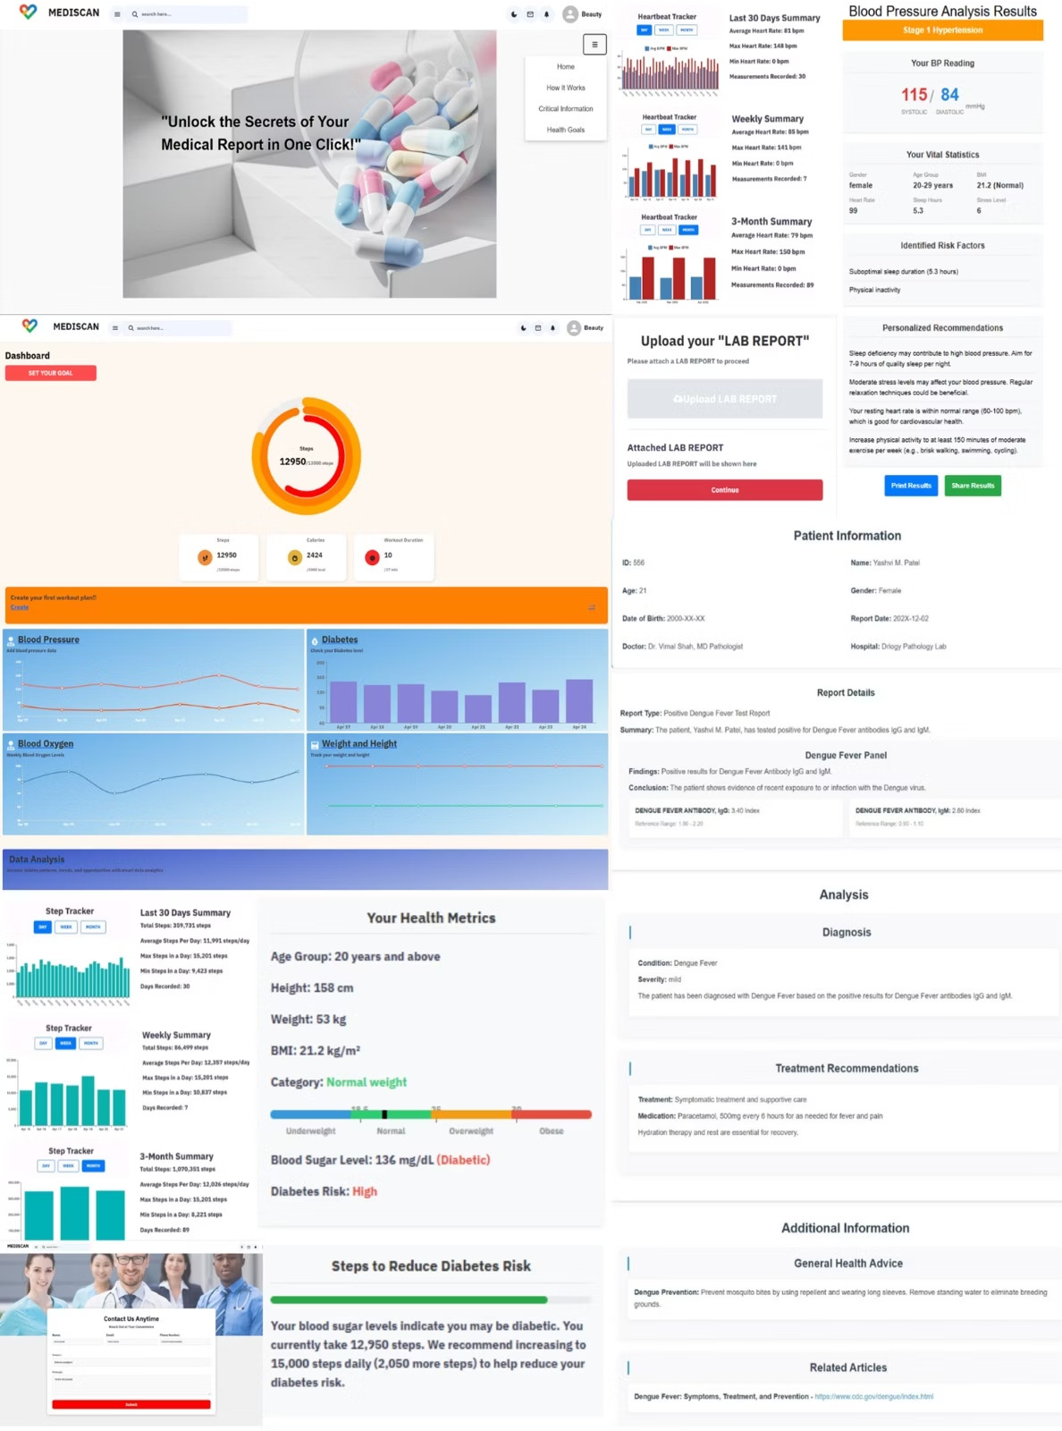
Introduction
Health Tracker
SmartWatch Dashboard
Medical Report Analyzer
Lab report Analysis

Slide 5


Problems we solve
Smartwatch
Implementation of SmartWatch Data
Lab Report
Guidance of Lab Report
1
2
3
Risk Management
Risk Management of Diabetes and Blood Pressure

Slide 6

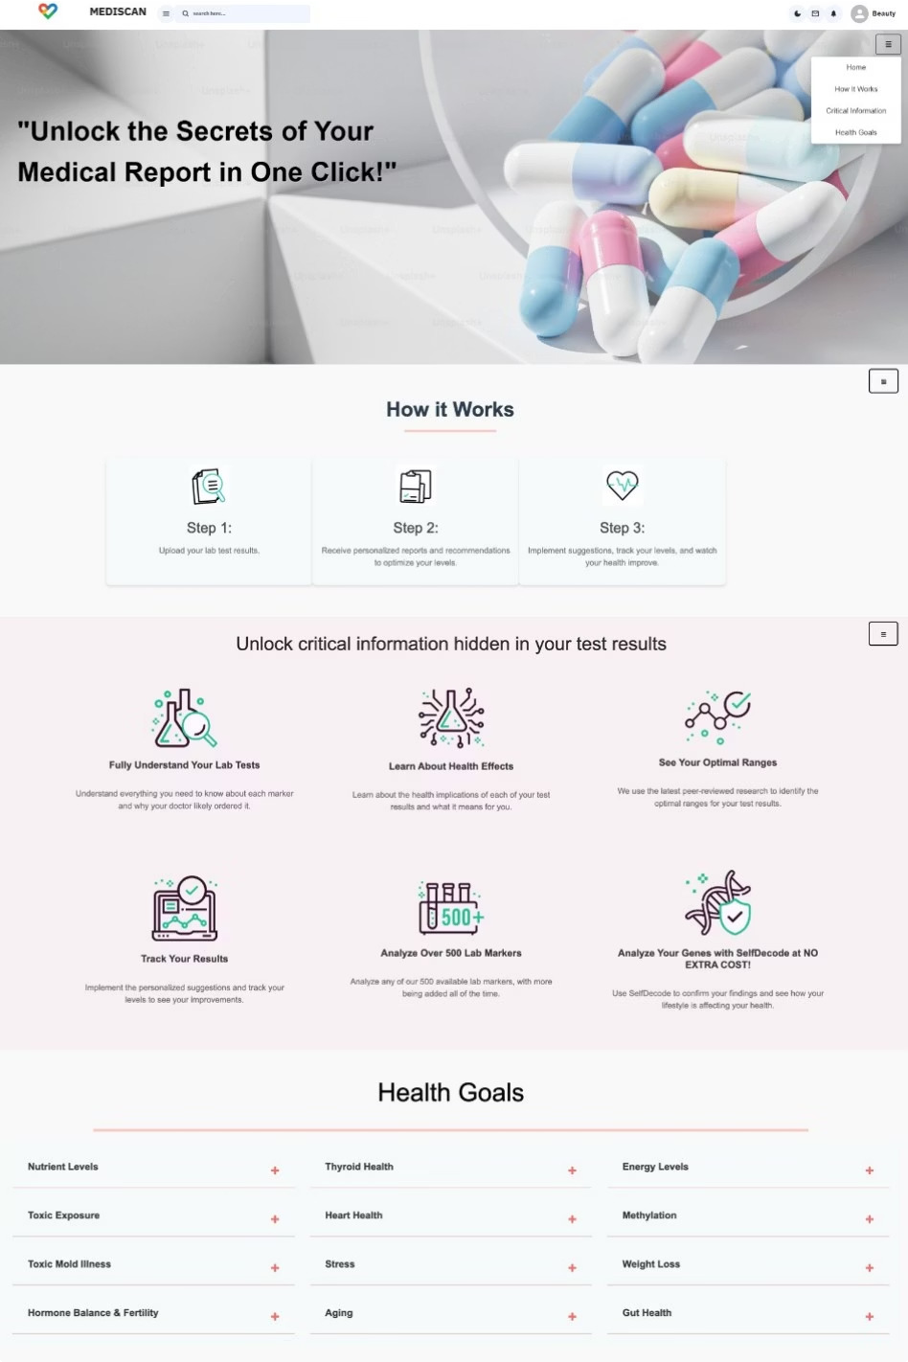
Home Page
Includes
How it work Critical Information Health Goal

Slide 7

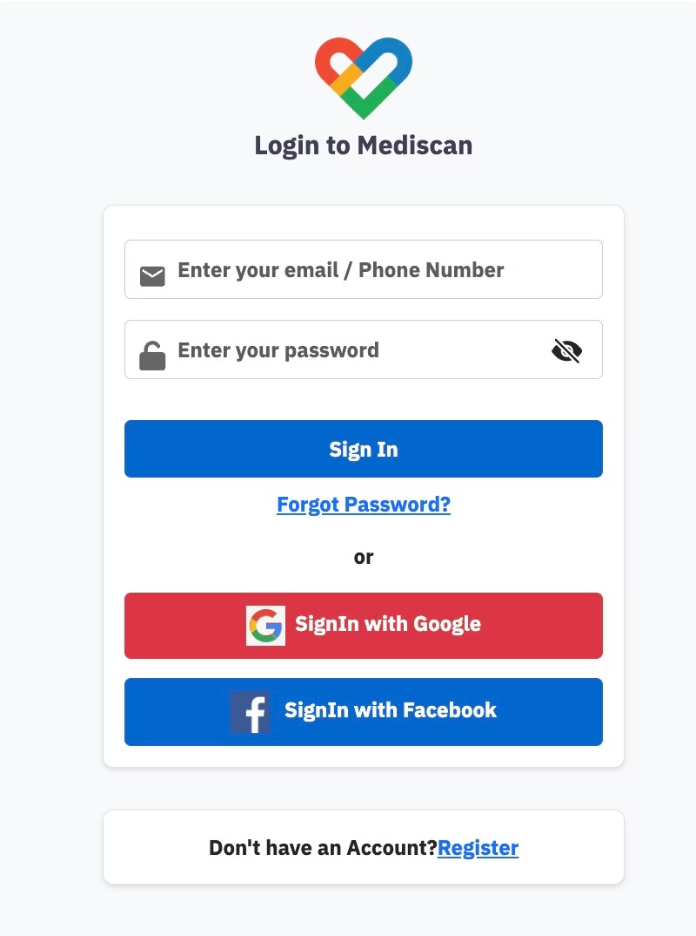
Login Page
Quick & Secure Registration
Enables users to log in safely using email/phone credentials or via Google and Facebook for faster sign-in
User-Friendly Interface
Features a clean UI with icon-based fields, password visibility toggle, and quick navigation for new users or
password recovery.
Seamless Dashboard Entry
Redirects users to their personalized health dashboard upon successful login, ensuring smooth platform
interaction.

Slide 8

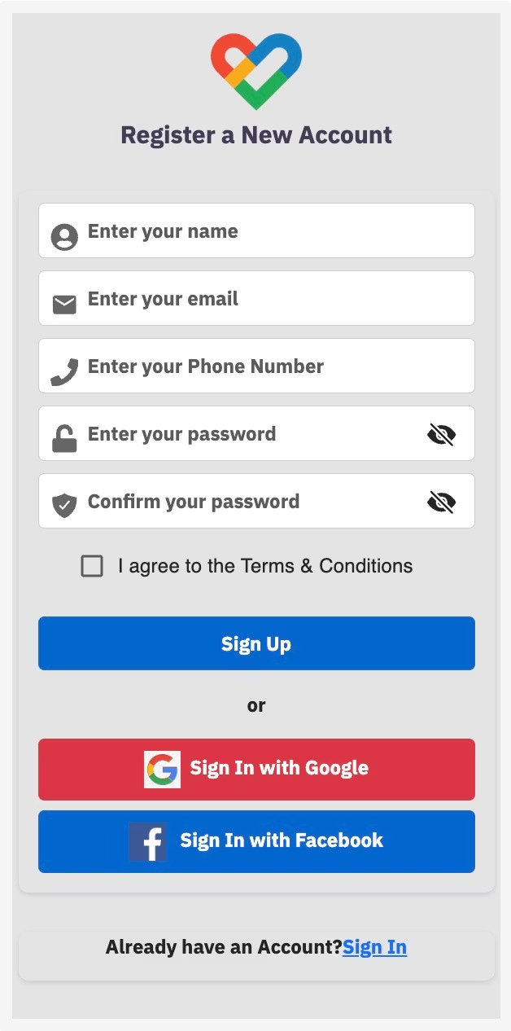
Sign Up Page
Quick & Secure Registration
Allows users to sign up with essential details, confirm passwords, and accept terms before account creation.
Social Media Integration
Offers easy sign-up options via Google and Facebook for faster onboarding.
Smooth Onboarding Flow
Redirects users to login upon successful registration, ensuring a seamless transition into the platform.

Slide 9

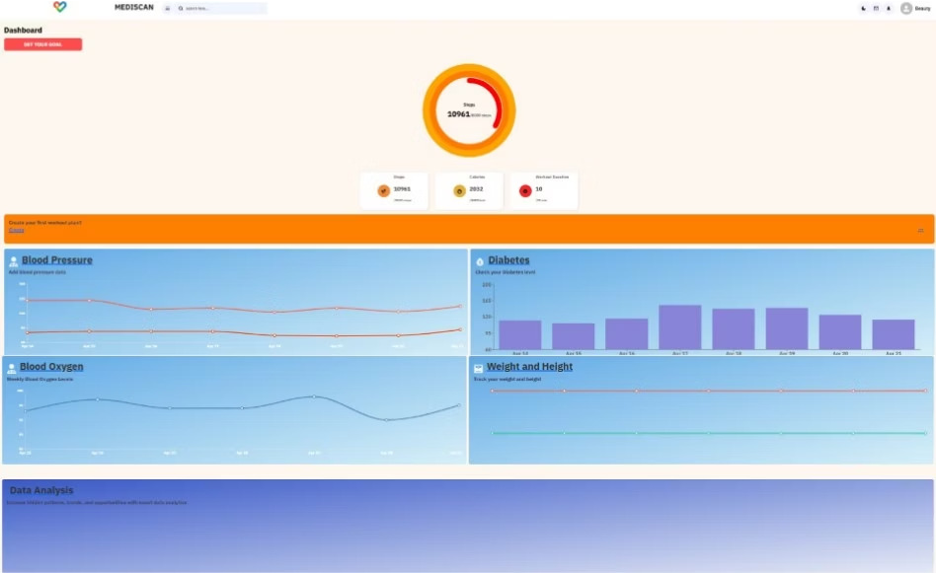
Health Tracker Dashboard
Purpose
To collect and analyze personal health data.
Key Functionalities
Dashboard Step Tracker
Blood Pressure Monitor Heartbeat Tracker Sleep Hours Tracker Stress Level Tracker Calorie Burn Tracker
Diabetes Risk Assessment Blood Indices Analysis

Slide 10

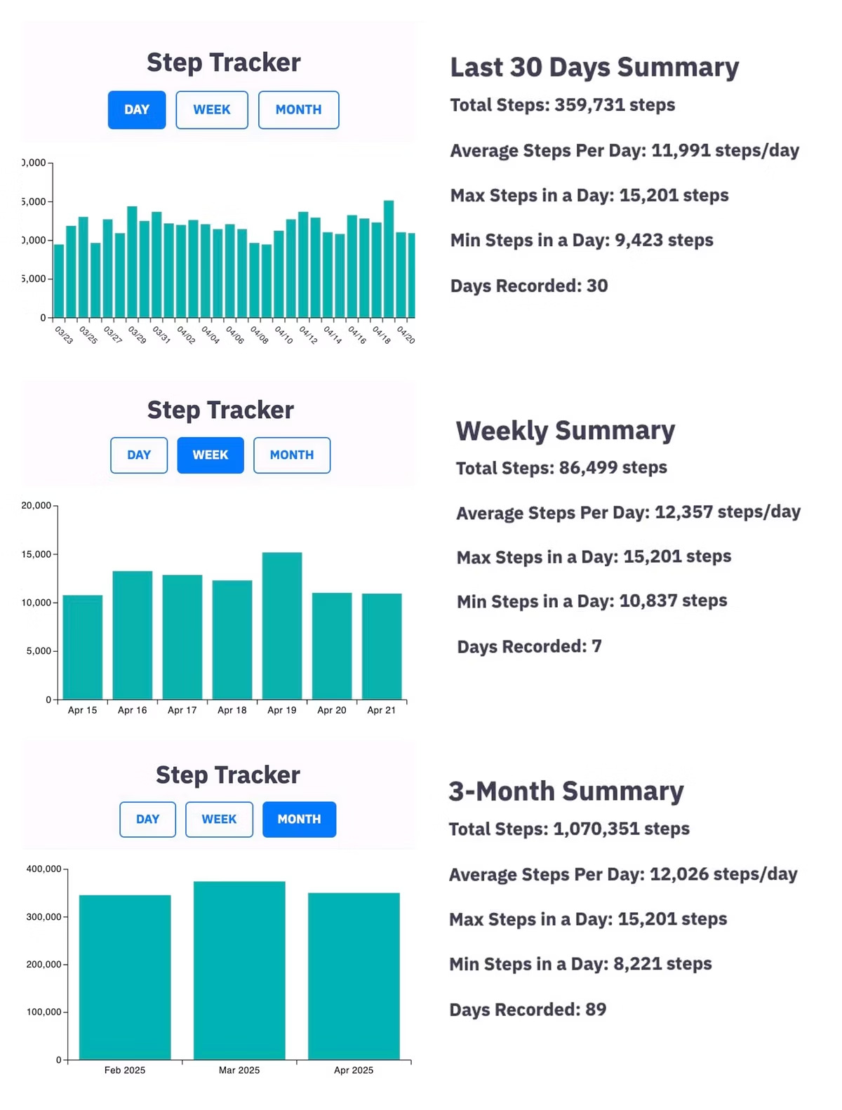


Step Tracker
Real-Time Step Tracking
Automatically count your steps throughout the day with precise and continuous monitoring.
Progress Summaries
Get detailed weekly and monthly overviews to visualize your activity trends and growth.
Goal Setting & Motivation
Set personal step goals and stay motivated by tracking your daily progress toward those targets.
Purpose: To help users build healthy habits by consistently tracking and improving their daily physical activity through step monitoring.
Benefit: Encourages regular movement and reduces sedentary behavior.

Slide 11

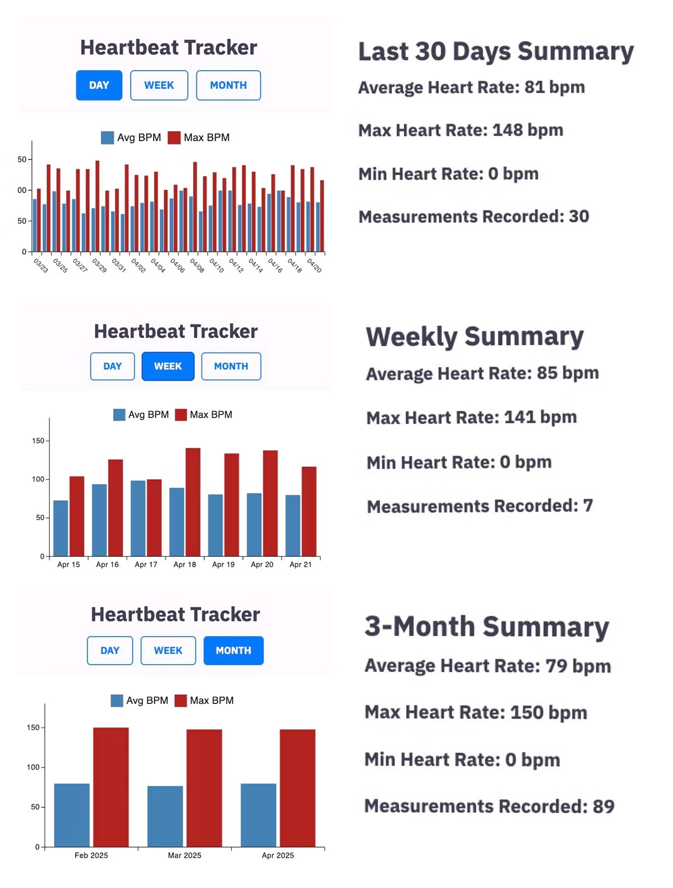



Heartbeat Tracker
Heart Rate Input & Monitoring
Easily record and manage your heart rate measurements with a user-friendly input system.
Health Analysis & Insights
Automatically analyze readings to categorize heart rate status and receive personalized health recommendations.
Historical Data Tracking
Track trends over time to better understand your cardiovascular health and detect any irregular patterns early.
Purpose: To help users maintain optimal heart health by offering real-time monitoring, personalized insights, and comprehensive tracking of heart rate patterns.
Benefit: Encourages users to stay active and meet fitness goals.

Slide 12

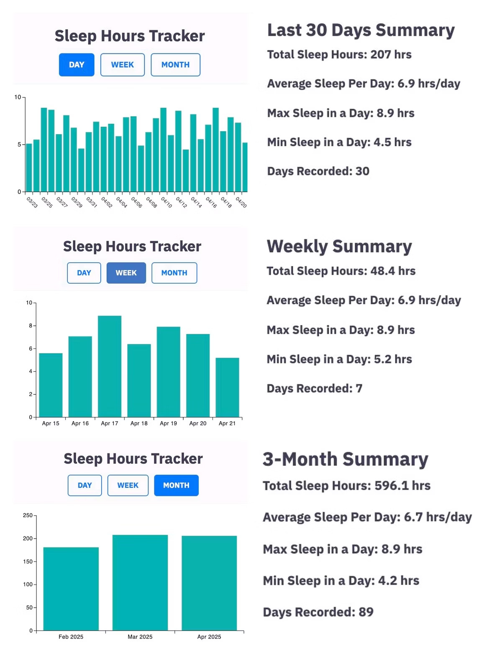


Sleep Tracker
Sleep Duration Input & Monitoring
Easily log your daily sleep hours with a simple and intuitive interface to monitor your rest patterns.
Sleep Quality Analysis & Insights
Analyze sleep data to evaluate the quality and consistency of rest, and receive personalized tips to improve sleep hygiene.
Historical Data Tracking
Track and visualize daily, weekly, and monthly sleep trends to understand your sleep behavior and identify any irregularities.
Purpose: To promote better sleep habits by offering accurate monitoring and insightful analysis.
Benefit: Helps users improve mental and physical well-being by ensuring adequate quality sleep.

Slide 13

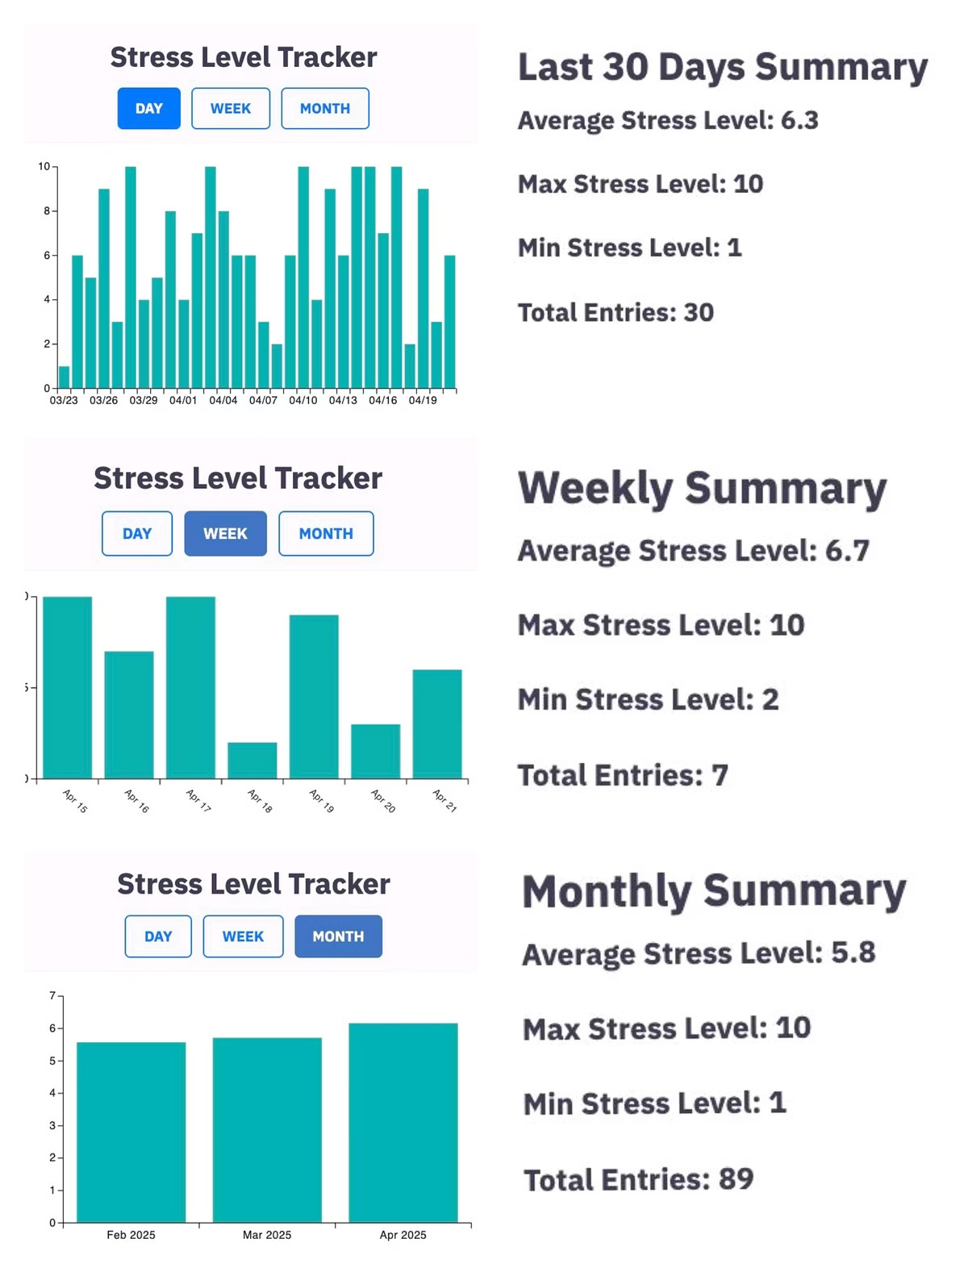

Stress Level Tracker
Stress Input & Monitoring
Easily record daily stress levels using a user-friendly interface, allowing you to track emotions.
Stress Quality Analysis & Insights
Automatically analyze patterns to determine stress intensity, providing personalized coping strategies and wellness tips.
Historical Data Tracking
Monitor daily, weekly, and monthly trends to understand fluctuations in stress levels and recognize long-term patterns .
Purpose: To help users manage and reduce stress through consistent tracking and practical recommendations .
Benefit: Supports emotional balance, enhances focus and productivity, and encourages healthier responses .

Slide 14

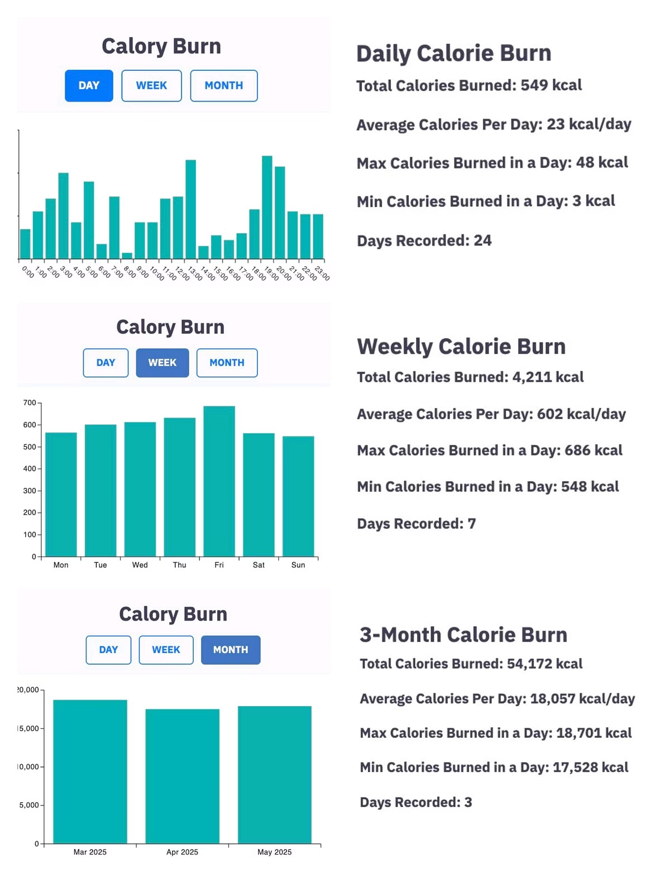
Calorie Burn Tracker
Calorie Input & Monitoring
Easily log and monitor the number of calories burned throughout the day with a user-friendly interface.
Calorie Burn Analysis & Insights
Analyze daily activity data to evaluate calorie expenditure and receive personalized suggestions to align with your fitness goals.
Historical Data Tracking
Track and visualize your calorie burn trends on a daily, weekly, and monthly basis to monitor progress .
Purpose: To help users manage and reduce stress through consistent tracking, insightful analysis, and practical recommendations for mental wellness.
Benefit: Encourages physical activity, supports weight goals, and promotes a healthier lifestyle through continuous calorie tracking.

Slide 15

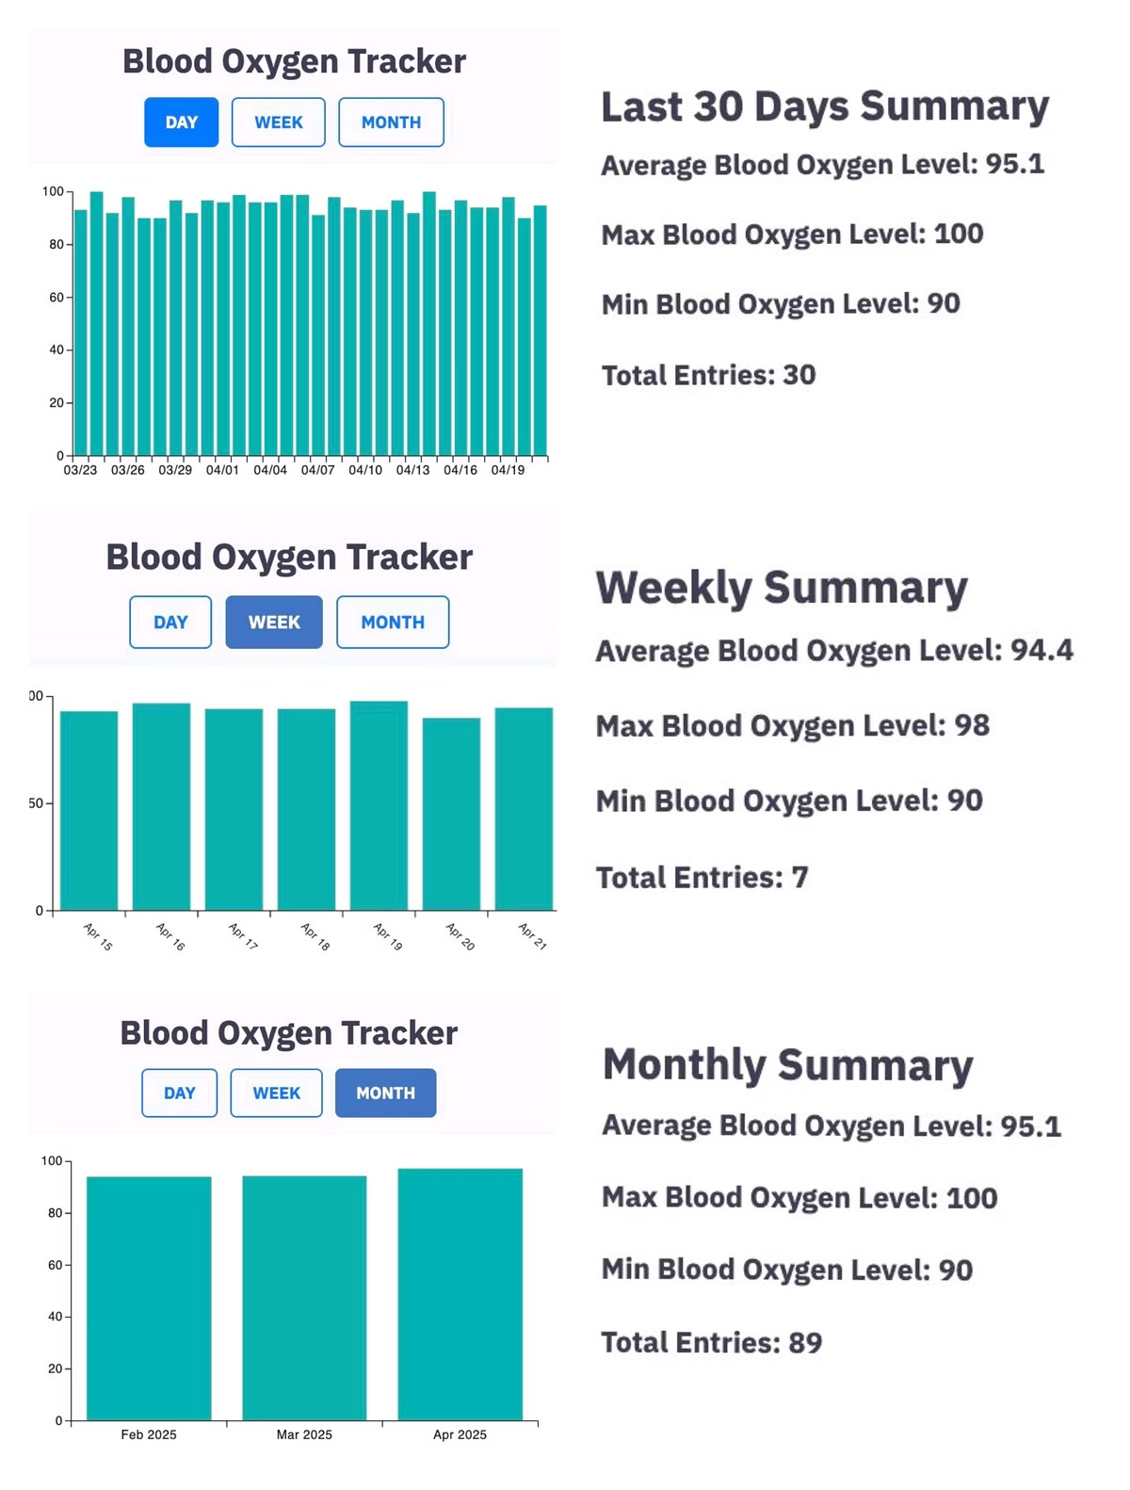


Blood Oxygen Tracker
Oxygen Level Input & Monitoring
Track your blood oxygen levels in real-time with a smart, intuitive interface.
Oxygen Analysis & Insights
Monitor oxygen trends daily, weekly, and monthly to track respiratory health and spot abnormalities.
Historical Data Tracking
Track blood oxygen changes with interactive bar charts for healthy consistency.
Purpose: Enable early detection and consistent monitoring to maintain optimal oxygen levels.
Benefits: Supports early diagnosis, boosts awareness, and guides lifestyle changes through oxygen data insights.

Slide 16

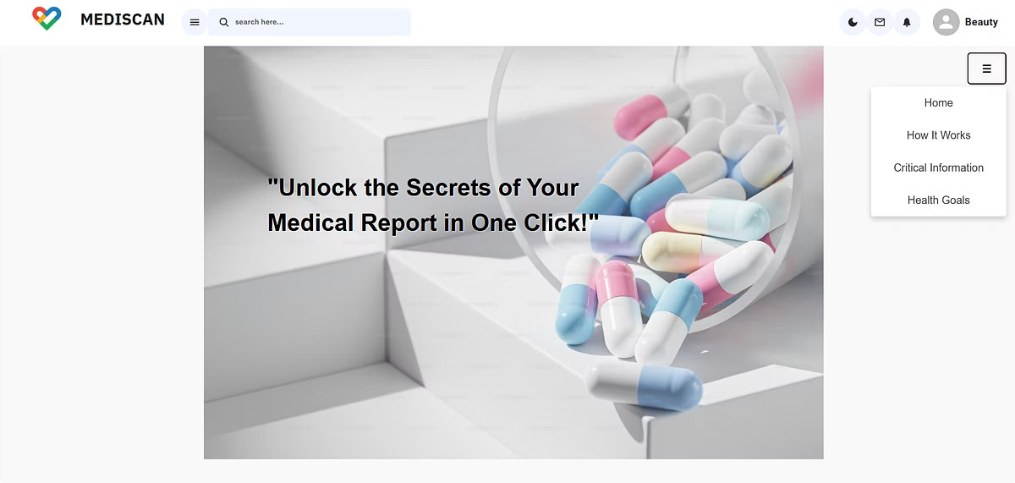
Medical Report Analyzer
Purpose
Turning lab reports into clear health insights.
Key Functionalities
Home
How it work Critical Information Health Goal
Report Upload
Analysis/Result

Slide 17

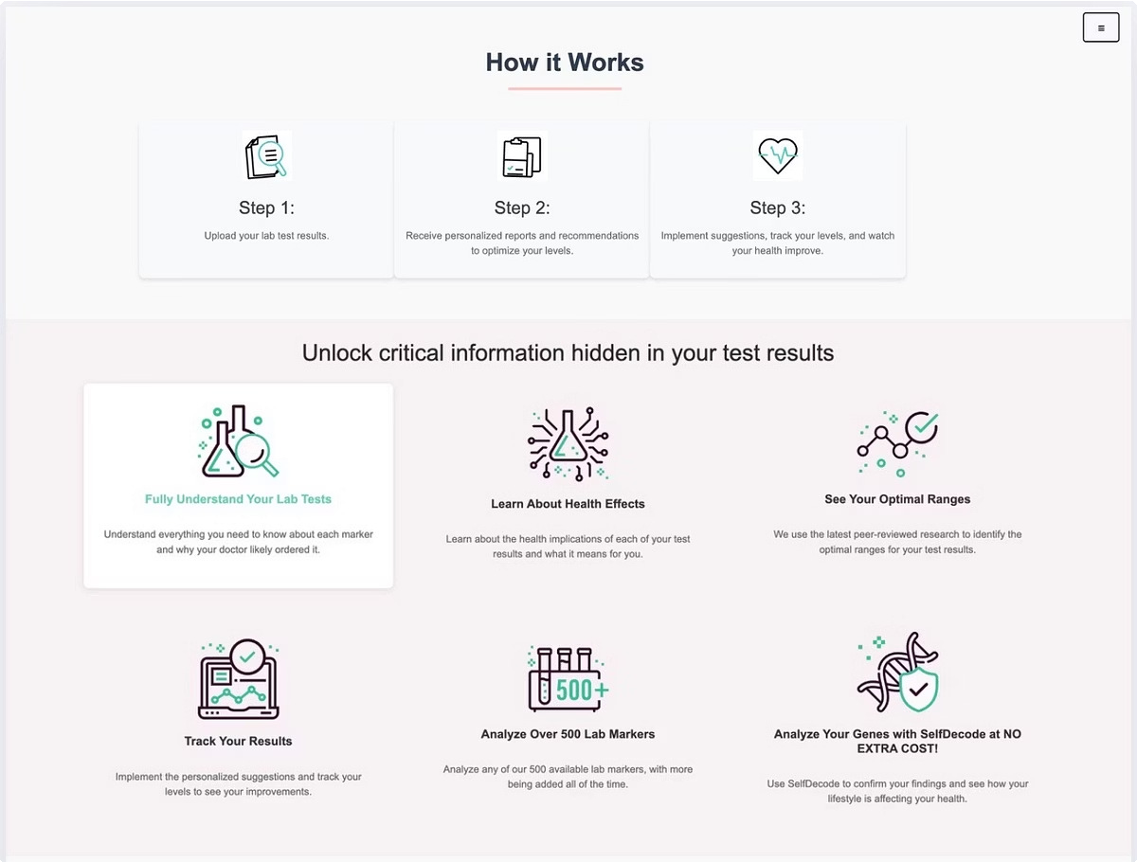
Additional Information of Website
How it Works
Guidance for report uploading
Critical Information
Insights & Analysis of generated report

Slide 18

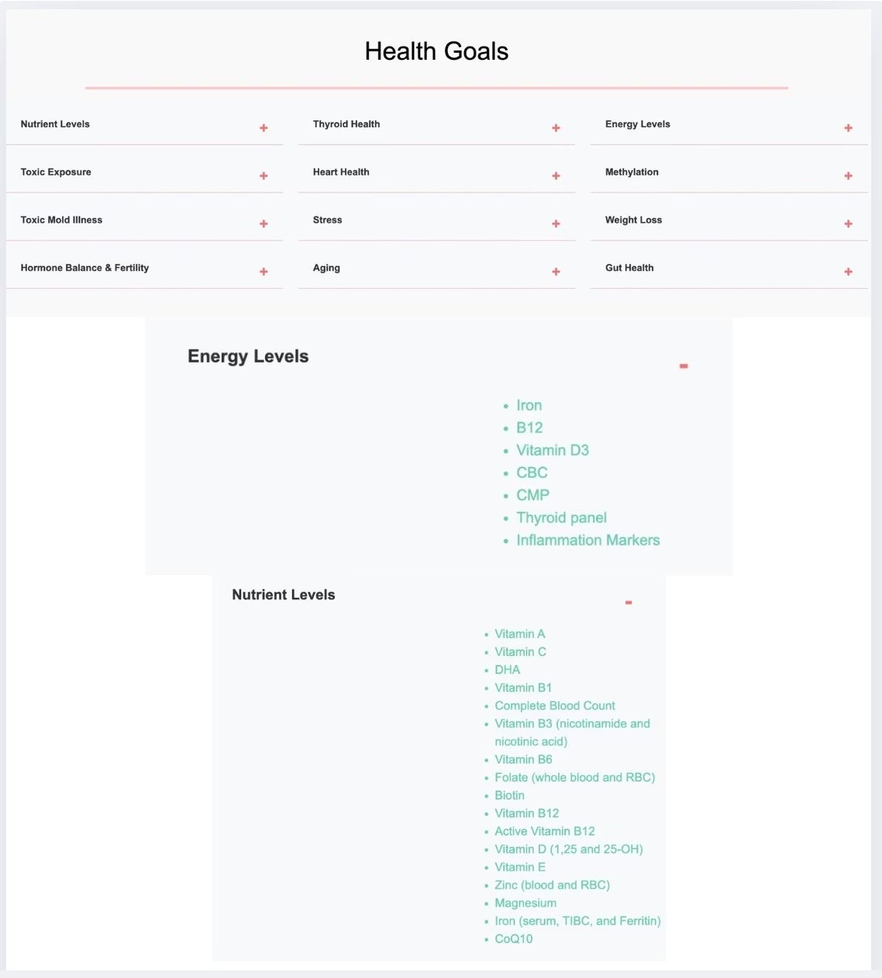
Additional
Information of Website
1 2
3
Biomarker Categorizati on
Each goal includes a curated set of relevant biomarkers (e.g., Vitamin D, TSH, Cortisol, Cholesterol, IGF- 1).
Expandable Sections
Users can expand or collapse each health goal section to explore the detailed test items that apply.
Goal- Oriented Navigation
Helps users take action by focusing on improving specific health areas based on their lab results.

Slide 19
Upload Lab Report
Functionality
Uploads and analyzes lab reports. Must upload only PDF format.

Slide 20

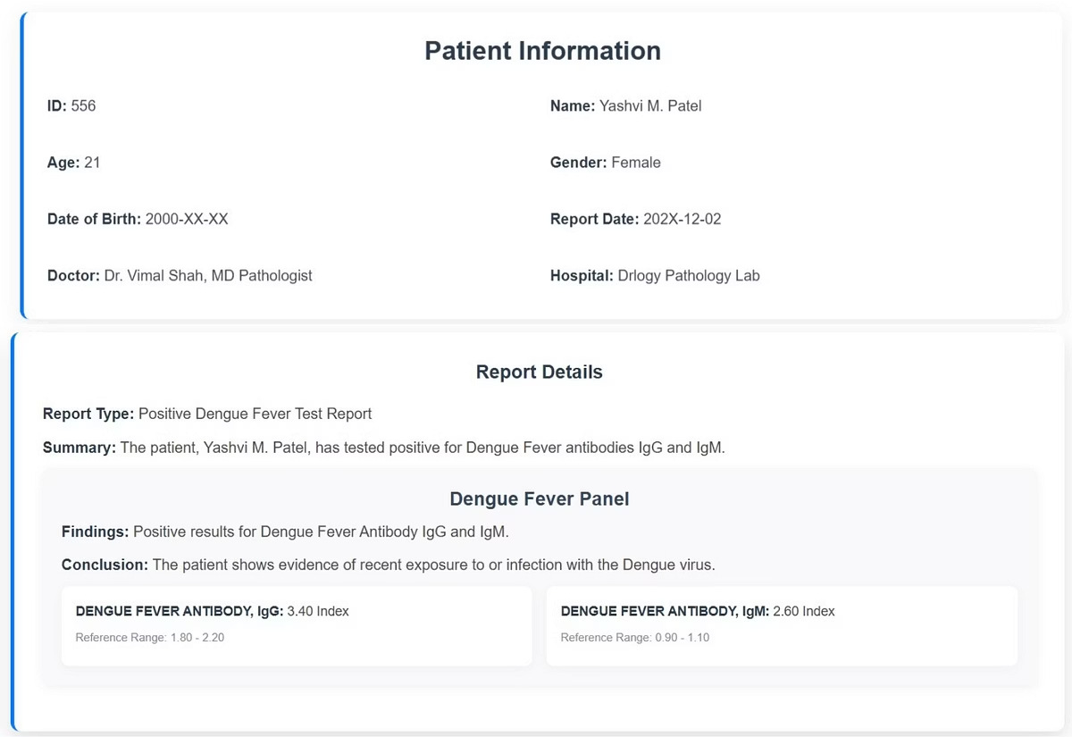

Report Details (Result)
Patient Information
Name, age, gender, and other basic details.
Report Details
Information like test name, date, lab name, and report summary.
Medical Analysis
Detailed breakdown of test results and metrics. Possibly includes charts or categorized values.
& Additional Information
Includes doctor¾s notes, recommendations, or follow-ups.
L Dynamic Rendering
Data is parsed and displayed only after it's successfully received and processed.

Slide 21

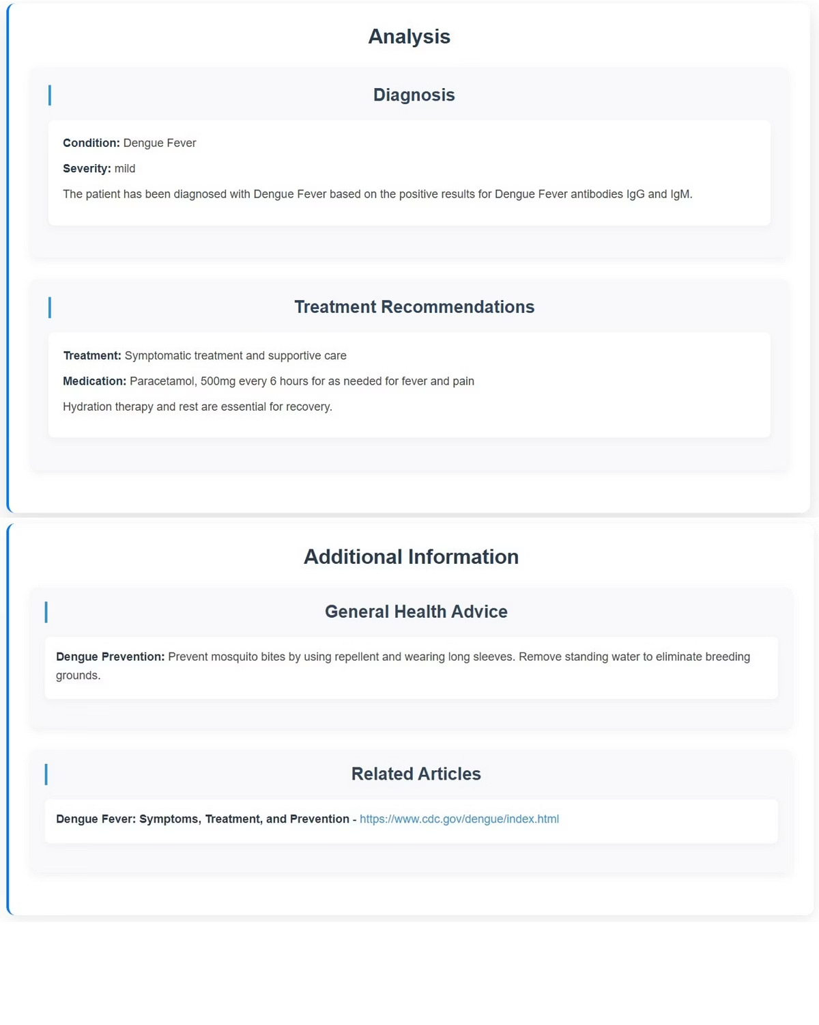
Report Details (Result)
Patient Information
Name, age, gender, and other basic details.
Report Details
Information like test name, date, lab name, and report summary.
Medical Analysis
Detailed breakdown of test results and metrics. Possibly includes charts or categorized values.
& Additional Information
Includes doctor¾s notes, recommendations, or follow-ups.
L Dynamic Rendering
Data is parsed and displayed only after it's successfully received and processed.

Slide 22

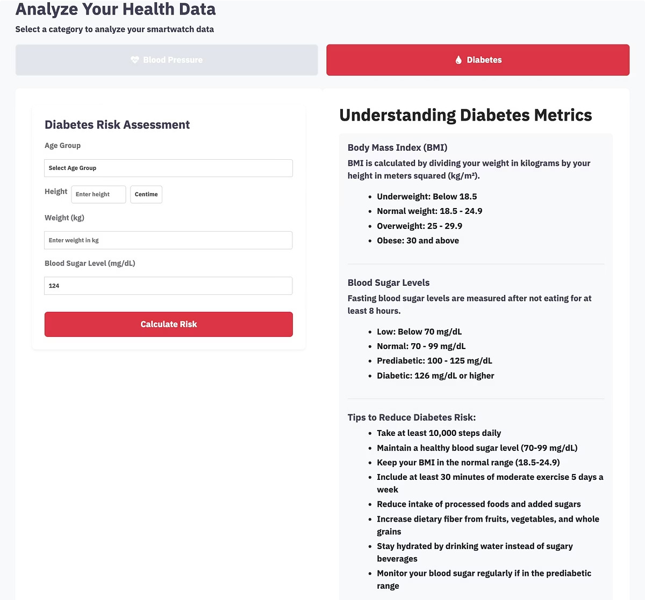


Diabetes Risk Analysis
Health Input & Monitoring
Enter your age, height, weight, and blood sugar to assess diabetes risk with user-friendly interface.
Risk Analysis & Insights
Evaluate BMI and blood glucose to assess diabetes risk and get personalized diet and lifestyle tips.
Historical Data Tracking
Track and visualize BMI, blood sugar, and diabetes risk over time to stay informed and proactive.
Purpose: Identify early diabetes signs through health metrics and get guidance for healthier choices.
Benefits:Supports early detection, weight management, and balanced blood sugar with data-driven insights.

Slide 23

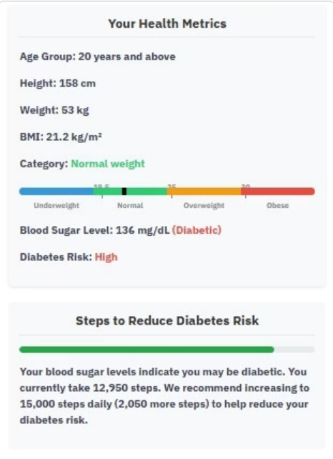
Analysis and Diagnosis
Personalized
Risk Assessment Made Simple
Calculates BMI and analyzes blood sugar to categorize users into diabetic, prediabetic, or healthy ranges.
Lifestyle Guidance
Provides daily step goals and actionable health tips based on individual risk level, BMI, and blood sugar.
Empowering Preventive Care
Helps users take control of their metabolic health with early detection, smart insights, and visual risk indicators.
2
1
3

Slide 24

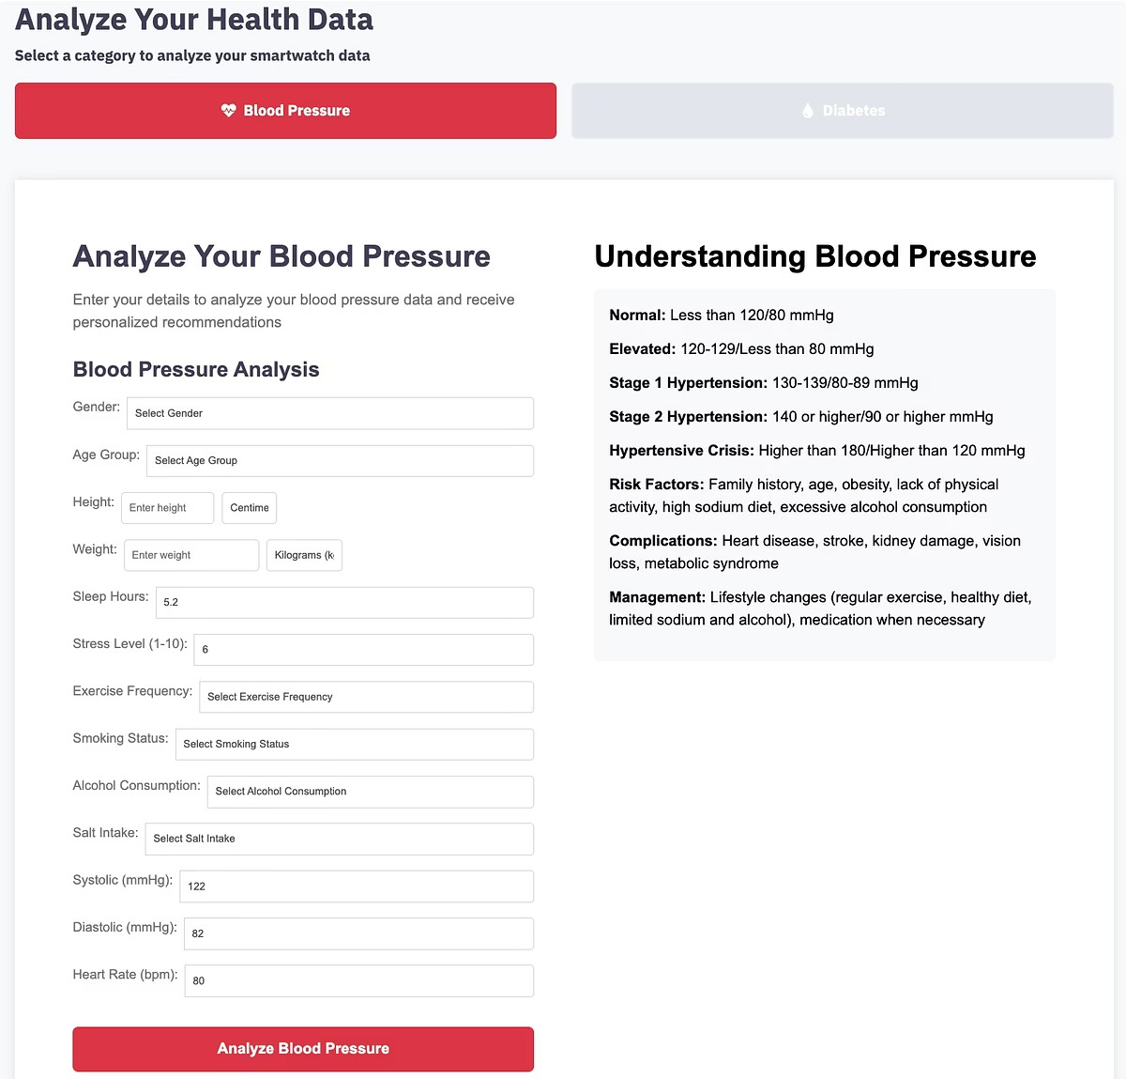
Blood Pressure Analysis
Blood Pressure Input & Monitoring
Easily enter your systolic and diastolic readings using a guided interface, designed for accurate tracking .
BP Analysis & Health Insights
Analyze BP to identify category and get personalized tips.
Historical Data Tracking
Monitor blood pressure trends over time4daily, weekly, and monthly4to detect patterns & risk factors.
Purpose: Helps users manage heart health with real-time analysis and insights.
Benefits:Detects hypertension early and empowers heart-healthy choices.

Slide 25

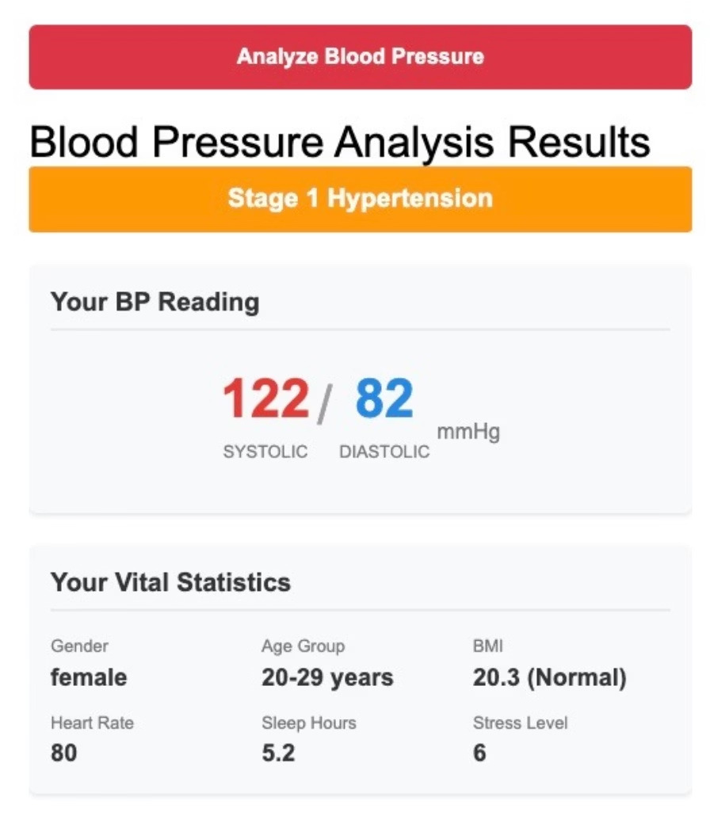

Analysis and Diagnosis
Risk Detection & Smart Tips:
Downloadable Health Report: Enables users to print or share a detailed PDF of their analysis, supporting easy communication with healthcare providers.
Personalized BP Analysis: Categorizes blood pressure levels and calculates BMI based on user input, providing instant, clear insights.
Identifies lifestyle-related risk factors and delivers tailored recommendation s for improving cardiovascular health.

Slide 26

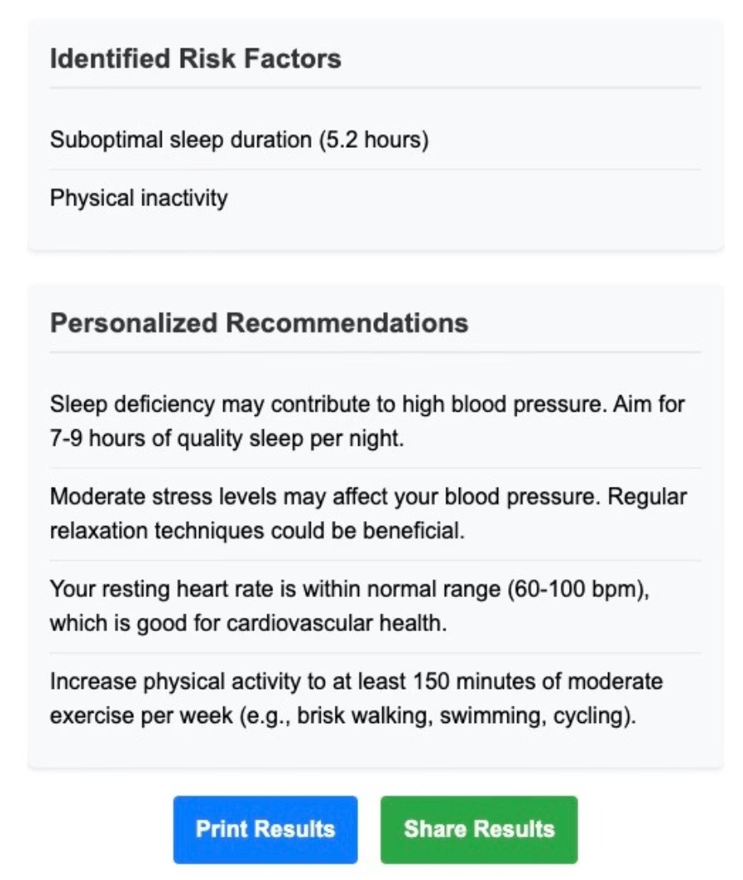
Analysis and Diagnosis
Risk Detection & Smart Tips:
Downloadable Health Report: Enables users to print or share a detailed PDF of their analysis, supporting easy communication with healthcare providers.
Personalized BP Analysis: Categorizes blood pressure levels and calculates BMI based on user input, providing instant, clear insights.
Identifies lifestyle-related risk factors and delivers tailored recommendation s for improving cardiovascular health.

Slide 27

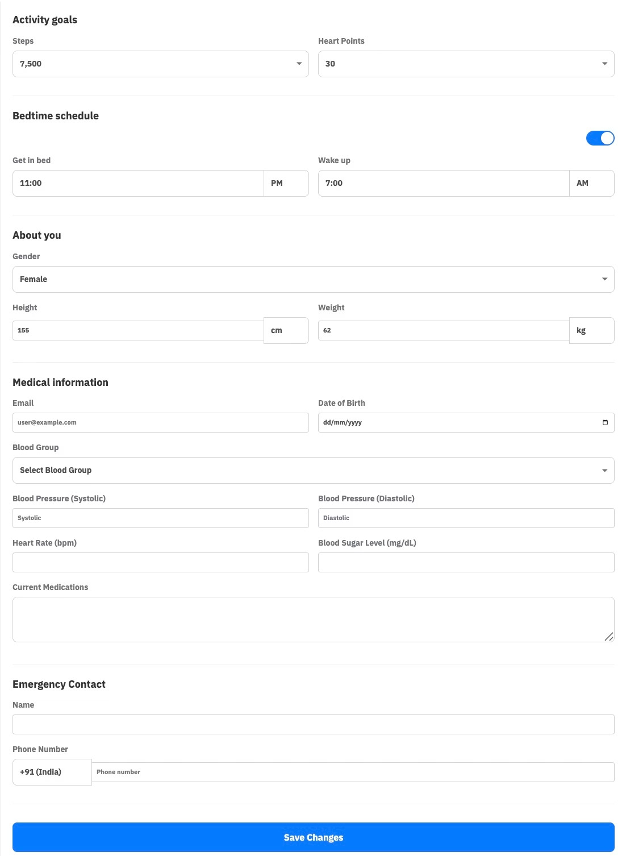
Patient Information
Personal Health Record Display
View essential personal and medical details, including patient ID, name, age, gender, date of birth, and more4all in one place.
Component Purpose
Captures and manages comprehensive user health data. Builds a centralized health profile for personalized tracking.
Organized & Readable Layout
Designed with a clean, structured format for quick reference, making it easy for both patients and healthcare providers to review details.

Slide 28

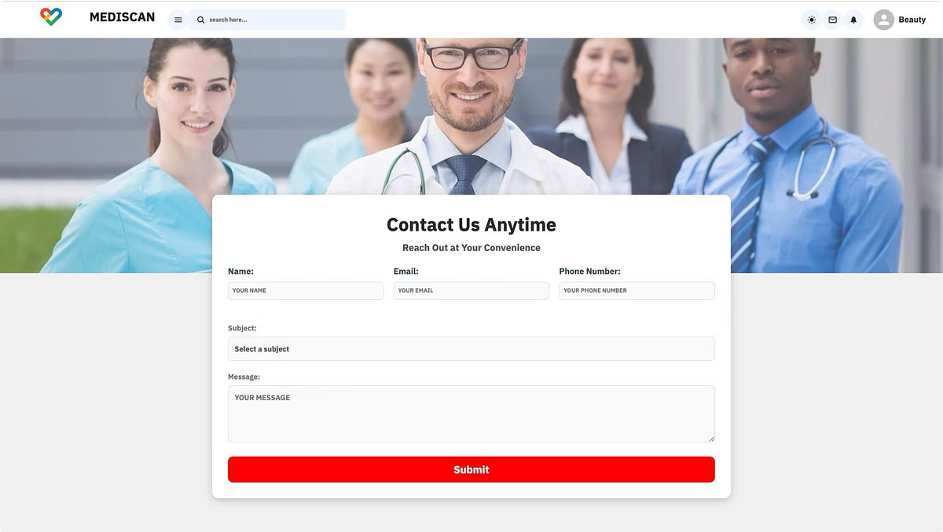
Contact us
Name, Email, Phone Number
1
Subject
Inquiry, Support and Feedback
2
3
Messages

Slide 29
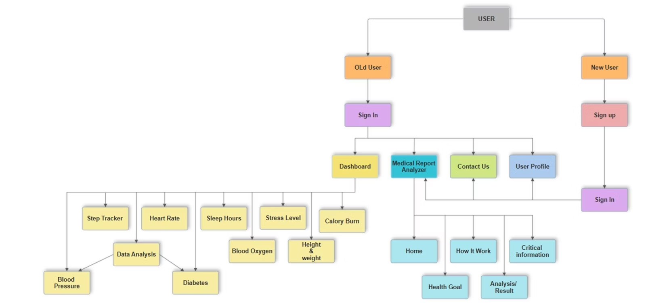
Flow Diagram

Slide 30

Thank You!
We appreciate your attention and interest in our system. We are dedicated to providing comprehensive health management solutions.
Share your feedback here!

